Slide 1
AI Core Project Part 1
The Scraper

Slide 2
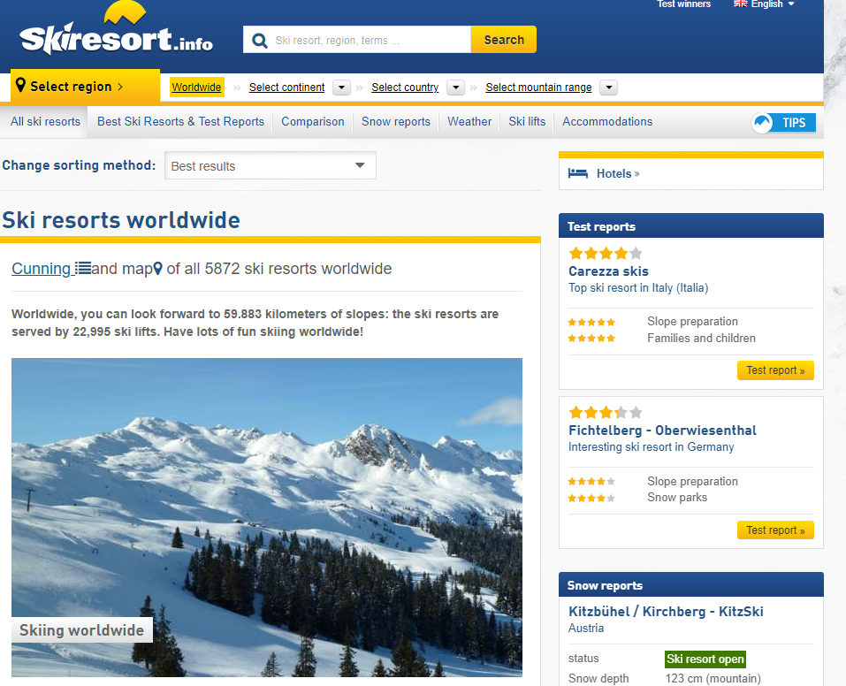
Data – Ski Resort Information
Data from skiresort.info
Rich database with nearly 6000 ski resorts / pistes etc. from all over the world
A lot of summary information with the potential for more detailed info

Slide 3
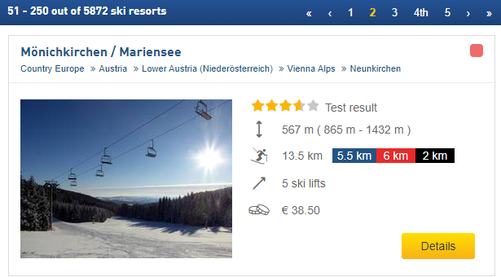
Data – Content
Each resort has summary table:
Name
Location (Continent, Country, Region etc.)
Rating from 5
Elevation Change
Max/Min Altitude
Ski piste lengths and breakdown of difficulty level
Number of ski lifts
Cost
Image
Link to further info

Slide 4
Data – What does it look like?
Column: % Missing Values
Name 0.0
Continent 0.0
Country 1.0
Web Link 0.0
Page Link 0.0
Star Rating 28.0
Elevation Change 13.0
Base Elevation 13.0
Max Elevation 13.0
Total Piste Length 16.0
Blue Piste Length 17.0
Red Piste Length 17.0
Black Piste Length 17.0
Ski Lifts 17.0
Ski Pass Cost 42.0
Photo URL 0.0

Slide 5
Data – What’s it for?
ML ideas:
Predict the cost from the other data, e.g. location, piste length, lifts
Future ideas (Might require getting extra info from the individual resort pages):
Predict season length based on altitude
Populate information using just the piste map (Would use CNN)
Website/app ideas:
Where to ski recommendation tool

Slide 6
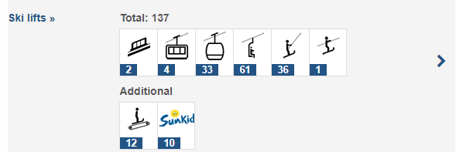
Data – More detailed info
Additional ski routes
Types of ski lifts
Costs for other age groups
General season
Opening times
Nearby towns/villages

